Slide 1
Design and Analysis of Algorithms (UE20CS251)
Unit II - Brute Force

Slide 2
Brute Force:
A straightforward approach, usually directly based on the problem statement and definitions of the concepts involved.
Examples:
Searching for a key of a given value in a list
Computing n!
Computing a^{n} (a > 0, n a nonnegative integer)
Hacking a password by matching all possible passwords.
“Force” by the computer in terms of effort, but simple in strategy to implement.
Trial and Error method of trying out in some order.
Exhaustive effort rather than employing intellectual strategies.
Often one of the easiest way to solve it.

Slide 3
Algorithm SequentialSearch(A[0..n-1], K)
//Outputs the index of the first element of A that
// matches K or -1 if there are no matching elements.
i ← 0
while (i < n) and (A[i] ≠ K) do
i ← i + 1
if (i < n) return i
return -1
Input size: n.
Basic Operation: (i < n) and (A[i] ≠ K)
C_{worst}(n) = n+1
C_{best}(n) = 1
Let ‘p’ be the probability of the search key present in the array.
C_{avg}(n) = p(n + 1) / 2 + (1 - p)(n + 1)

Slide 4
Algorithm SequentialSearch(A[0..n-1], K)
Input Size: n
Basic Operation : (i < n) and (A[i] ≠ K)
C_{worst}(n) = Count of the basic operation at the max
= n + 1 ∈ 𝚹(n)
C_{best}(n) = 1 ∈ 𝚹(1)
C_{avg}(n) = from (n+1)/2 to (n+1) depending on the probability of search key being present in the input array.
C_{avg}(n) ∈ 𝚹(n)

Slide 5

Brute-Force String Matching:
In an n-characters text, search for the first occurrence of m-character pattern.
There are n-m+1 substrings of length m in the text of length n. Find the first such substring which matches with the pattern.
Find i, the index of the leftmost character of the first matching substring in the text such that

Slide 6
NaiveStringMatch(T[0..n-1], P[0..m-1])
for i ← 0 to n-m
j ← 0
while (j < m and T[i+j] = P[j])
j ← j + 1
if(j = m) return i
return -1
Analysis:
Input Size: n, m
Basic Operation : (T[i+j] = P[j])
Worst case : ?
Best case = ?
…

Slide 7
A brute force way of sorting:
Find an arrangement of elements of an array, which is sorted.
Strategy: For every possible arrangements of an array, check if it’s sorted, and return the arrangement which is sorted.
boolean SortByExhaustiveSearch( A[0..n-1] )
//Sorts array A by trying out all possible arrangements of elements of the array.
//Input: An array A of orderable elements by ≤.
//Output: Sorted array A by ≤.
for each permutation p[0..n-1] of array A
if (isSorted( p[0..n-1] ))
return p[0..n-1]

Slide 8
Write an algorithm to check if the array is sorted.
boolean isSorted( A[0..n-1] )
//Checks if the array A is sorted.
//Input: An array A of orderable elements by ≤.
//Output: Return TRUE if array is sorted.
// FALSE otherwise.
...

Slide 9
Write an algorithm to check if the array is sorted.
boolean isSorted( A[0..n-1] )
//Checks if the array A is sorted.
//Input: An array A of orderable elements by ≤.
//Output: Return TRUE if array is sorted.
// FALSE otherwise.
for i ← 0 to n-2
if(A[i] > A[i+1]) //not in order
return FALSE
return TRUE

Slide 10
Sort by fixing the problems while checking for sortedness.
SortByCheckingSortedness( A[0..n-1] )
//Sorts by Checking sortedness.
//Input: An array A of orderable elements by ≤.
//Output: Sorted array A.
for i ← 0 to n-2
if(A[i] > A[i+1])
Swap A[i] with A[i+1]
Does it sort?

Slide 11
Sort by fixing the problems while checking for sortedness.
SortByCheckingSortedness2( A[0..n-1] )
//Sorts by Checking sortedness.
//Input: An array A of orderable elements by ≤.
//Output: Sorted array A.
while (TRUE)
for i ← 0 to n-2
if(A[i] > A[i+1])
Swap A[i] with A[i+1]
if(isSorted( A[0..n-1] ))
return
Does it sort and that too in a finite amount of time?

Slide 12
Sort by fixing the problems while checking for sortedness.
SortByCheckingSortedness3( A[0..n-1] )
//Sorts by Checking sortedness.
//Input: An array A of orderable elements by ≤.
//Output: Sorted array A.
for k ← 0 to n-2 //n-1 passes
for i ← 0 to n-2 //n-1 consecutive pairs
if(A[i] > A[i+1])
Swap A[i] with A[i+1]
if(isSorted( A[0..n-1] ))
return
It should sort. Can it be improved?

Slide 13

Algorithm BubbleSort( A[0..n-1] )
//Sorts by Bubble Sort algorithm.
//Input: An array A of orderable elements by ≤.
//Output: Sorted array A.
for i ← 0 to n-2 //n-1 passes
for j ← 0 to n-2-i //last i elements are sorted
if(A[j] > A[j+1])
Swap A[j] with A[j+1]
return
Can it still be improved?

Slide 14
Algorithm BubbleSortImproved( A[0..n-1] )
//Sorts by an improved Bubble Sort algorithm.
//Input: An array A of orderable elements by ≤.
//Output: Sorted array A.
for i ← 0 to n-2 //n-1 passes
anySwaps ← FALSE
for j ← 0 to n-2-i //last i elements are sorted
if(A[j] > A[j+1])
Swap A[j] with A[j+1]
anySwaps ← TRUE
if(anySwaps = FALSE)
Break out of loop

Slide 15
Algorithm BubbleSort_Recursive(A[0..n-1])
//Sorts by an improved Bubble Sort algorithm.
//Input: An array A of orderable elements by ≤.
//Output: Sorted array A.
anySwaps ← FALSE
for i ← 0 to n-2
if(A[i] > A[i+1])
Swap A[i] with A[i+1]
anySwaps ← TRUE
if(anySwaps = TRUE)
BubbleSort_Recursive(A[0..n-2])

Slide 16
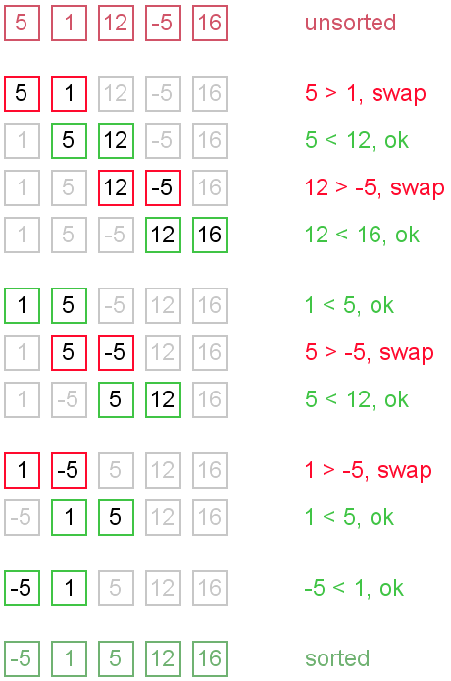

Slide 17
Analysis of Bubble Sort:
Algorithm BubbleSort( A[0..n-1] )
//Sorts by Bubble Sort algorithm.
//Input: An array A of orderable elements by ≤.
//Output: Sorted array A.
for i ← 0 to n-2 //n-1 passes
for j ← 0 to n-2-i //last i elements are sorted
if(A[j] > A[j+1])
Swap A[j] with A[j+1]
return

Slide 18
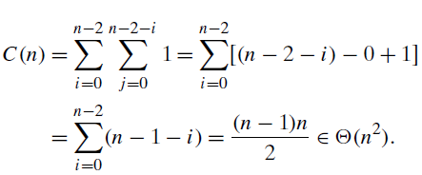
Algorithm BubbleSort( A[0..n-1] )
Input Size: n
Basic Operation: (A[j] > a[j+1])
C_{worst}(n) = n * (n - 1) / 2 ∈ Θ(n²)

Slide 19
Bubble Sort (improved version):
Algorithm BubbleSortImproved( A[0..n-1] )
//Sorts by an improved Bubble Sort algorithm.
//Input: An array A of orderable elements by ≤.
//Output: Sorted array A.
for i ← 0 to n-2 //n-1 passes
anySwaps ← FALSE
for j ← 0 to n-2-i //last i elements are sorted
if(A[j] > A[j+1])
Swap A[j] with A[j+1]
anySwaps ← TRUE
if(anySwaps = FALSE)
return
return

Slide 20
Algorithm BubbleSortImproved( A[0..n-1] )
Input Size: n
Basic Operation : (a[j] > a[j+1])
C_{worst}(n) = n * (n - 1) / 2 ∈ Θ(n²)
C_{best}(n) = (n - 1) ∈ Θ(n)
Basic Operation : Swap
C_{worst}(n) = n * (n - 1) / 2 ∈ Θ(n²)
C_{best}(n) = 0 ∈ Θ(1)

Slide 21
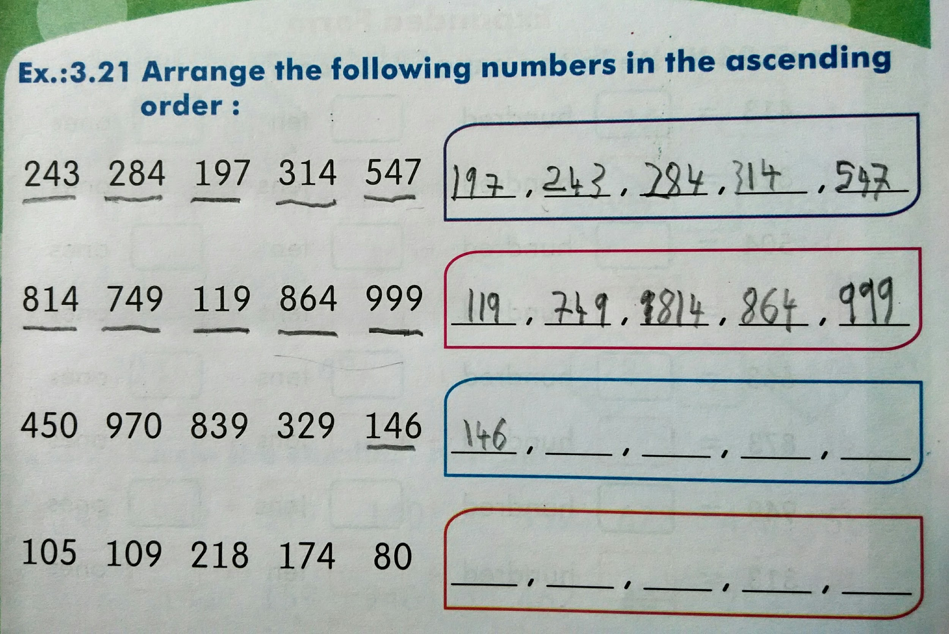
Yet another way of sorting by brute-force.

Slide 22
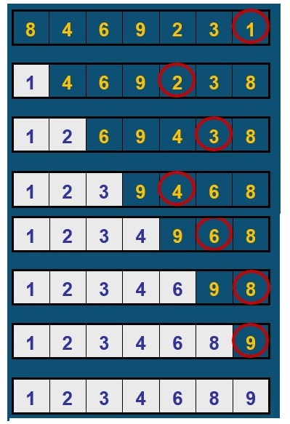
Selection Sort:
Example: 8 4 6 9 2 3 1

Slide 23
Selection Sort:
Find the smallest of the unsorted array and place it at the beginning of the unsorted array. Reduce the unsorted array by excluding the first one, which is already in its final position. Repeat sorting the unsorted array as long as there is only one element left in the unsorted array.
Algorithm SelectionSort_Recursive(A[0..n-1])
//Sorts a given array by Selection Sort.
//Input: An array A[0..n-1] of orderable elements.
//Output: Array A[0..n-1] sorted in ascending order.
if(n ≤ 1) return
min ← index of the smallest among A[0..n-1]
Swap A[0] with A[min]
SelectionSort_Recursive(A[1..n-1])

Slide 24

Selection Sort:
Find the smallest of the unsorted array and place it at the beginning of the unsorted array. Reduce the unsorted array by excluding the first one, which is already in its final position.
Algorithm SelectionSort(A[0..n-1])
//Sorts a given array by Selection Sort.
//Input: An array A[0..n-1] of orderable elements.
//Output: Array A[0..n-1] sorted in ascending order.
for i ← 0 to n-2
min ← index of the smallest among A[i..n-1]
Swap A[i] with A[min]

Slide 25
Algorithm SelectionSort(A[0..n-1])
//Sorts a given array by Selection Sort.
//Input: An array A[0..n-1] of orderable elements.
//Output: Array A[0..n-1] sorted in ascending order.
for i ← 0 to n-2
min ← i
for j ← i+1 to n-1
if(A[j] < A[min]) min ← j
Swap A[i] with A[min]
return A

Slide 26
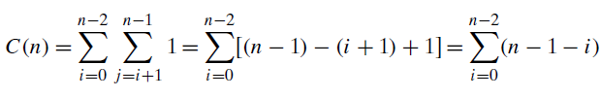

Analysis of Selection Sort:
Input Size: n (size of the list)
Basic Operation: Comparison (A[j] < A[min])
C_{best}(n) = C_{worst}(n) = C_{avg}(n)

Slide 27
Polynomial Evaluation:
p(x)= a_{n}x^{n} + a_{n-1}x^{n-1} +… + a₁x¹ + a₀ at x=x₀
Algorithm Polynomial(n, x₀, a[0..n])
//Output: Value of the polynomial at x = x₀.
p ← 0.0
for i ← n downto 0 do
power ← 1
for j ← 1 to i do //compute x^{i}
power ← power * x₀
p ← p + a_{i} * power
return p
Input Size: n
Basic Operation : power ← power * x₀
C(n) = n * (n + 1) / 2 ∈ Θ(n²)

Slide 28
p ← 0.0
for i ← n downto 0 do
power ← 1
for j ← 1 to i do //compute x^{i}
power ← power * x
p ← p + a[i] * power
return p
--------------------------------
p ← a[0]
power ← 1
for i ← 1 to n do
power ← power * x
p ← p + a[i] * power
return p

Slide 29
Polynomial Evaluation:
p(x)= a_{n}x^{n} + a_{n-1}x^{n-1} +… + a₁x¹ + a₀ at x=x₀
Algorithm Polynomial2(n, x₀, a[0..n])
//Output: Value of the polynomial at x = x₀.
p ← a₀
power ← 1
for i ← 1 to n do
power ← power * x //compute x^{i}
p ← p + a_{i} * power
return p
Input Size: n
Basic Operation : power ← power * x₀
C(n) = n ∈ Θ(n)

Slide 30
Exhaustive Search:
A brute force solution to a problem involving search for an element with a special property, usually among combinatorial objects such as permutations, combinations, or subsets of a set.
Method:
Generate a list of all potential solutions to the problem in a systematic manner.
Evaluate potential solutions one by one, disqualifying infeasible ones and, for an optimization problem, keeping track of the best one found so far.
When search ends, announce the solution(s) found.

Slide 31
Travelling Salesman Problem:
Given n cities and distances between each pair of cities, find the shortest tour that passes through all other cities and returns to the origin city.

Slide 32
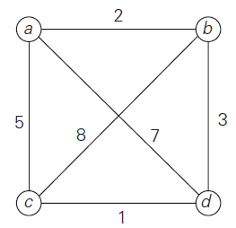
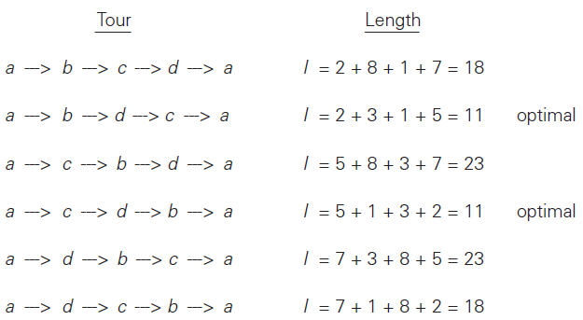
Travelling Salesman Problem:

Slide 33
Algorithm Travelling Salesperson Problem
mincost ← Infinity
for each permutation of (n - 1) cities
cost ← 0
for each edge in the Hamiltonian circuit
cost ← cost + cost of the edge
if (cost < mincost)
mincost ← cost
return mincost
Input Size: n
Basic Operation : addition of cost of an edge
C(n) = n * (n - 1)! = n! ∈ Θ(n!)

Slide 34
Sorting by exhaustive search:
Find an arrangement of elements of an array, which is sorted.
Strategy: For every possible arrangements of an array, check if it’s sorted, and return the arrangement which is sorted.
boolean SortByBruteForce( a[0..n-1] )
//Sorts array a by trying out all possible arrangements of elements of the array.
//Input: An array a of orderable elements by ≤.
//Output: Sorted array a by ≤.
for each permutation p[0..n-1] of array a
if (isSorted( p[0..n-1] ))
return p[0..n-1]

Slide 35
The Assignment Problem:
Each one of n people are assigned one of n jobs, exactly one person per job. The cost of assigning person i to job j is C[i, j]. Find an assignment that minimizes the total cost.
Job 1 Job 2 Job 3 Job 4
┌ ┐
P1 │ 9 2 7 8 │
P2 │ 6 4 3 7 │
P3 │ 5 8 1 8 │
P4 │ 7 6 9 4 │
└ ┘
Strategy:
Generate all legitimate assignments,
Compute cost of each assignment, and
Select the cheapest one.

Slide 36
Cost Matrix
Job 1 Job 2 Job 3 Job 4
┌ ┐
P1 │ 9 2 7 8 │
P2 │ 6 4 3 7 │
P3 │ 5 8 1 8 │
P4 │ 7 6 9 4 │
└ ┘
Assignment (col.#s) Total Cost
1, 2, 3, 4 9+4+1+4 = 18
1, 2, 4, 3 9+4+8+9 = 30
1, 3, 2, 4 9+3+8+4 = 24
1, 3, 4, 2 9+3+8+6 = 26
1, 4, 2, 3 9+7+8+9 = 33
1, 4, 3, 2 9+7+1+6 = 23
2, 1, 3, 4 2+6+1+4 = 13 etc.

Slide 37
Algorithm AssignmentProblem(C[0..n-1, 0..n-1])
//Input: n x n cost matrix C.
//Output: Cost of the cheapest assignment.
mincost ← Infinity
for each permutation of n jobs
cost ← 0, person ← 1
for each job in the assignment
cost ← cost + C[person, job]
person ← person + 1
if (cost < mincost) mincost = cost
return mincost
Input Size: n, Basic Operation : cost + C[person, job]
C(n) = n * n! ∈ Θ(n*n!)

Slide 38
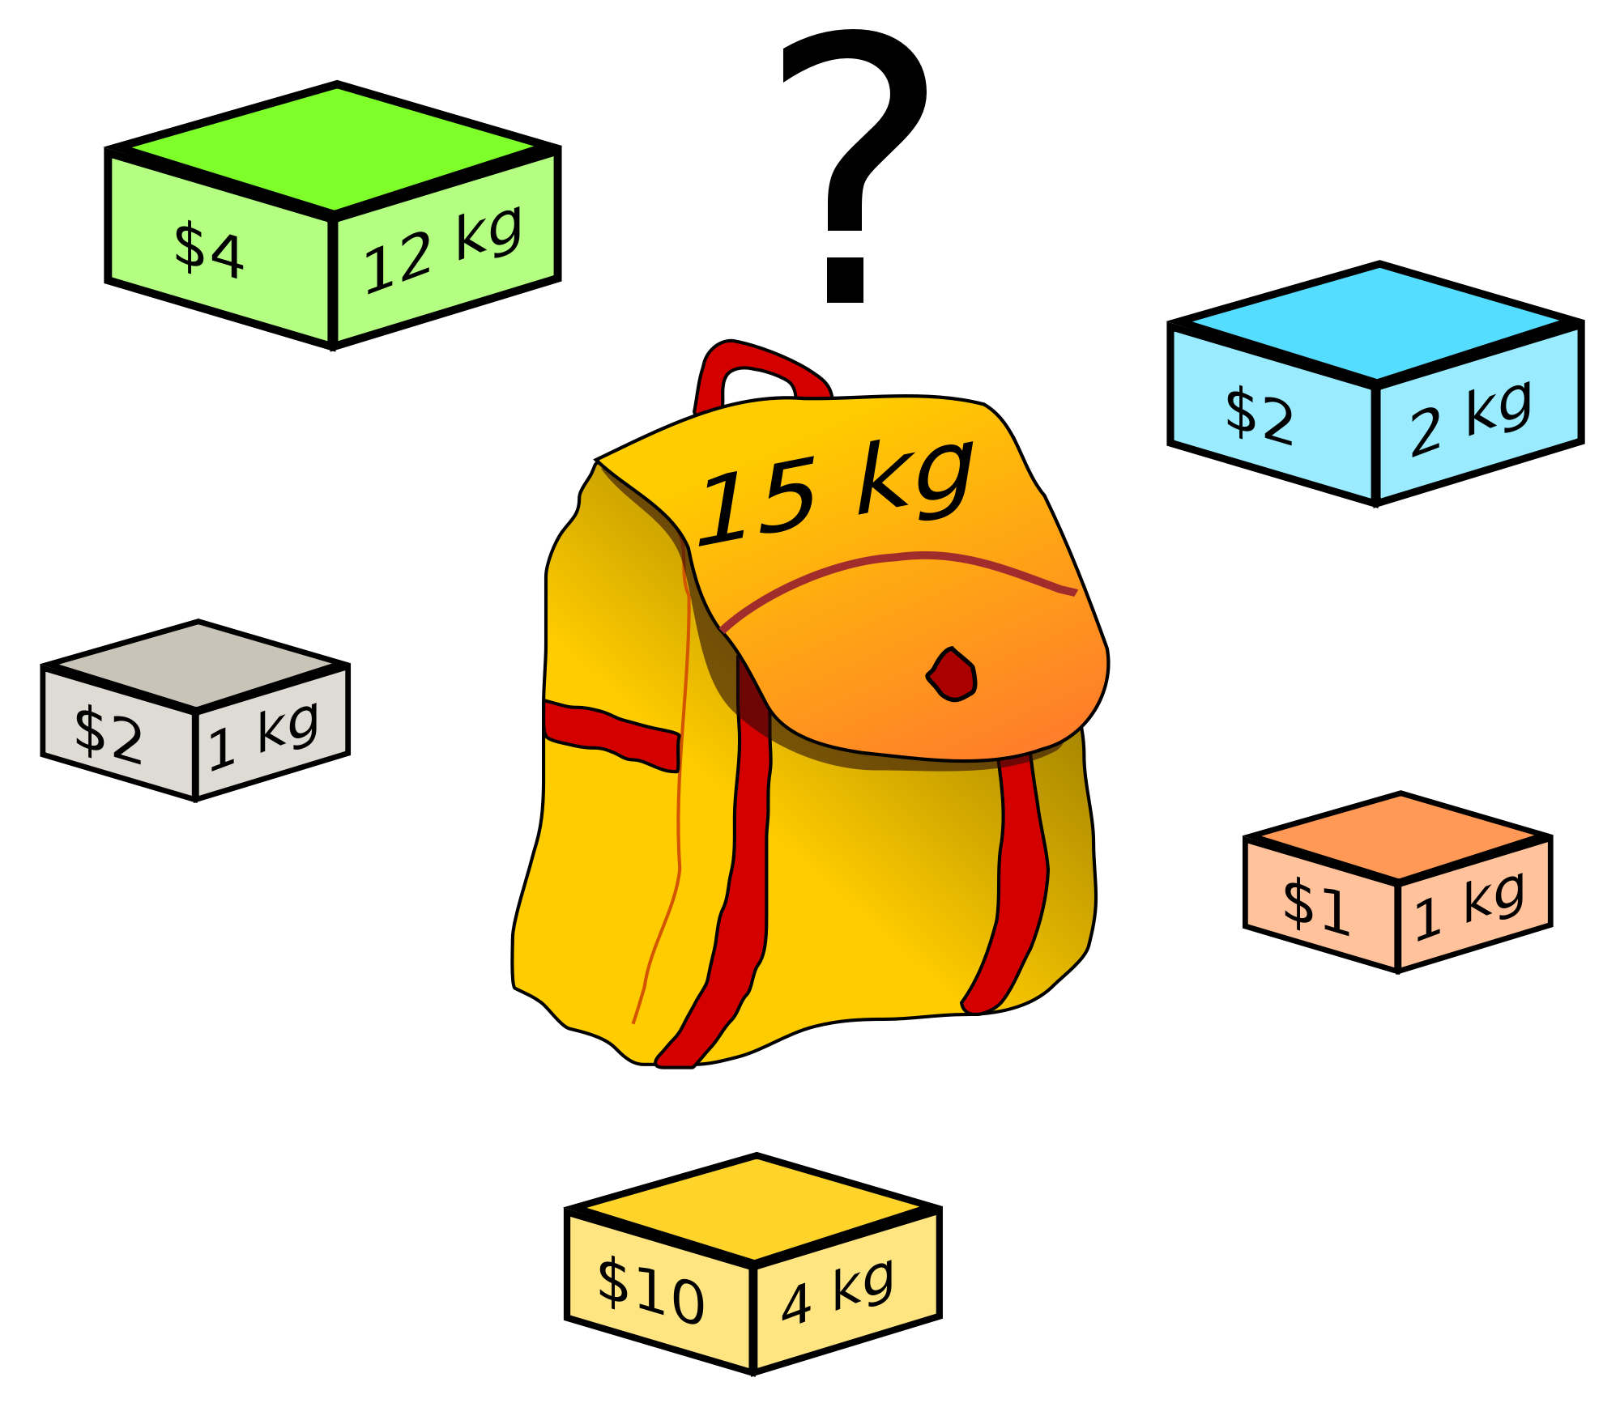
Knapsack Problem:
Given n items:
weights:w₁ w₂ … w_{n}
values: v₁ v₂ … v_{n}
a knapsack of capacity W
Find most valuable subset of the items that fit into the knapsack.

Slide 39
Knapsack Problem:
Given n items:
weights: w₁ w₂ … w_{n}
values: v₁ v₂ … v_{n}
a knapsack of capacity W
Find most valuable subset
of the items that fit into the knapsack.
Ans: {B,O,Y,W} 8kg, $15
What if the green object weighs 8 kg instead of 12 kg?

Slide 40
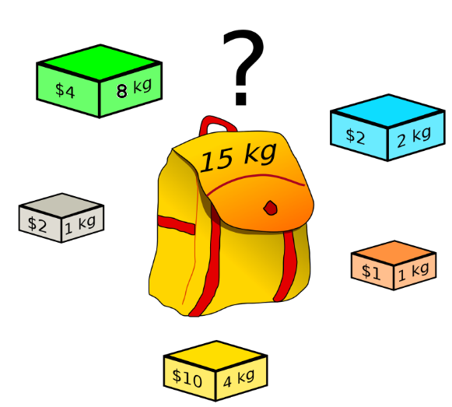
Knapsack Problem:
What if the green object weighs 8 kg instead of 12 kg?
Ans:
{G,B,Y,W}
15kg, $18

Slide 41
Example:
Knapsack capacity W=16
item weight value
1 2 $20
2 5 $30
3 10 $50
4 5 $10
{2,3} with value $80 is optimal.
C(n) ∈ 𝛀(2^{n})
Subset Total weight Total value
{} 0 $0
{1} 2 $20
{2} 5 $30
{3} 10 $50
{4} 5 $10
{1,2} 7 $50
{1,3} 12 $70
{1,4} 7 $30
{2,3} 15 $80
{2,4} 10 $40
{3,4} 15 $60
{1,2,3} 17 -
{1,2,4} 12 $60
{1,3,4} 17 -
{2,3,4} 20 -
{1,2,3,4} 22 -

Slide 42
Write a brute-force algorithm to find an optimal solution for the 0/1 Knapsack Problem.
Given n items:
weights: w₁ w₂ … w_{n}
values: v₁ v₂ … v_{n}
a knapsack of capacity W
Find most valuable subset
of the items that fit into the knapsack.

Slide 43
Multiplication of Large Integers:
Consider the problem of multiplying two (large) n-digit integers represented by arrays of their digits such as:
A = 12345678901357986429 B = 87654321284820912836
Brute-Force Strategy:
a₁ a₂ … a_{n}* b₁ b₂ … b_{n}
d₁₀d₁₁d₁₂ … d_{1n}
d₂₀ d₂₁d₂₂ … d_{2n}
… … … … … … …
d_{n0}d_{n1}d_{n2} … d_{nn}
2135 * 4014
8540
2135+
0000++
8540+++
_________________________________________________
8569890

Slide 44
Write a brute-force algorithm to multiply two arbitrarily large (of n digits) integers.
12345678 * 32165487
86419746
98765424+
49382712++
61728390+++
74074068++++
12345678+++++
24691356++++++
37037034+++++++
_______________________________________________________________
397104745215186
Basic Operation:
single-digit multiplication
C(n) = n² one-digit multiplications
C(n) ∈ Θ(n²)

Slide 45
a = [1, 2, 3, 4]; n = 4; what(a, n)
algo what(a[0 .. n - 1])
for i <- 0 to n - 1 do
t <- a[i]; a[i] <- a[n - 1 - i]; a[n - 1 - i] = t
What is the content of array a after the execution of this algorithm?

Slide 46
Ans:
1 2 3 4

Slide 47
algo min_diff(head)
min <- _____
for(i <- head; i != NULL ; i <- i.next)
for(_______; j != NULL ; j <- j.next)
diff <- abs(i.key - j.key)
if diff < min then
diff <- min
return diff
a) fill the blanks
b) find the # of comparisons (diff < min) in terms of # of nodes in the list

Slide 48
infinite (any big value)
j <- i.next
n(n-1)/2

Slide 49
This algorithm is supposed to return 1 if two arrays have the same content otherwise 0
algo compare_arrays(a[0 .. n-1], b[0..n-1])
i <- 0
while i < n and a[i] = b[i] do
i <- i + 1
return a[i] = b[i]
a) Correct the return statement.

Slide 50
a) i == n

Slide 51
a = [1, 2, 3, 4, 5]; n = 5; what(a, n)
algo what(a[0 .. n - 1])
i <- 0; j <- n – 1
while i != j do
t <- a[i]; a[i] <- a[j]; a[j] = t; i <- i + 1; j <- j - 1
What does this algorithm do?
What happens if n is even?

Slide 52
reverses the elements of an array
get stuck in an infinite loop; indexes reach outside the array bounds

Slide 53
algorithm what(a[0 .. n-1])
// s1[0 .. n-1] and s2[0 .. n-1] are arrays
s1[0] <- a[0]
for i <- 1 to n-1 do
s1[i] <- s1[i - 1] + a[i]
s2[0] <- a[n-1]
for i <- 1 to n-1 do
s2[i] <- s2[i – 1] + a[n – 1 – i]
a) what do s1 and s2 contain?

Slide 54
s1 and s2 contain cumulative sums from left and right ends.

Slide 55
This algorithm is supposed to count pairs of elements (a[i], a[j]) such that a[i] < a[j] for i < j.
algorithm what(a[0 .. n-1])
c <- 0
for i <- 0 to ____ do
for j <- ____ to n – 1 do
if a[i] < a[j] then
c <- c + 1
return i
a) Fill up the blanks to achieve the stated result.
b) What will be the value of c in terms of n if elements are distinct and in ascending order

Slide 56
n -2
i + 1
n(n-1)/2

Slide 57
The algorithm is supposed to check whether a given array is sorted and return 1 if sorted; 0 otherwise.
Algorithm check(a[0 .. n – 1])
i <- 0
while i < n and a[i] < a[i + 1] do
i <- i + 1
if i < n then
return 1
else
return 0
a) find and correct the bug(s).

Slide 58
While i < (n – 1)
if (i < n) return 0 else return1

Slide 59
algorithm what(a[0 .. n-1, 0 .. n-1])
res <- 0
for i <- 0 to n - 1 do
found <- false; j <- 0
while not found and (j < n) do
found <- a[i, j] = 0
j <- j + 1
if found then
res <- res + 1
return res
what does the algorithm do?
What is the basic size?
Count the number of comparisons – a[i,j] = 0 in the best case and worst case

Slide 60
i) counts the number of rows having at least one zero in the given matrix
ii) size : n
iii) worst case : Σ Σ 1 = n^2
i = 0 to n - 1 j = 0 to n – 1
best case : Σ 1 = n
i = 0 to n - 1

Slide 61
algo what(a[l ..r] , l, r)
if l = r then
return a[l]
if a[l] > a[r] then
return what(a, l + 1, r)
else
return what(a, l, r - 1)
i) what does the given function do?
ii) What is the basic operation?
iii) What is the basic size?
iv) express and solve the recurrence relation for number of operations?

Slide 62
i) finds the min in the array section l to r
ii)comparison a[l] <a[r]
iii) # of elements in the array section : r – l + 1
iv) one possible solution
let n = r – l + 1
c(1) = 0
c(n) = 1 + c(n – 1)
c(n) = 1 + 1 + c(n-2)
c(n) = n – 1 + c(1) = n – 1 = r – l

